Slide 1

Online Face Recognition Attendance System
Prof. Haitham Farouk
Prof. Hussain Sharaf
Faculty of Computers and Information
Suez University - 2021

Slide 2
1.0 Introduction

Slide 3
Team Members
Abdo Mosa (171015)
Mark Adel (181042)
Mahmoud Ramadan (181029)
Menna Shazly (181037)
Ahmed Mahrous (181006)
Nada Nasr (171026)
Abdelrahman Raafat (181012)

Slide 4
1.4 Software Engineering Course of Actions
Agile
Iterative Development
Clean Code
Code Refactoring
CD/CI
Pair Programming
Collective Ownership
Version Control git/GitHub
Reuse-Oriented
Requirements Prioritization
Maintain Simplicity (KISS)
Open Standards
Change Tolerance
Sustainable Pace
Reflect and Adjust
Test-Driven Development
Dependability
Backlog

Slide 5
1.5 Used Technologies
Python
Flask Framework
REST API
Flask-Admin
Flask-WTF
Flask-Bcrypt
Face-Recognition Package
ORM (SQLAlechemy)
Jinja2
OpenCV
Numpy
HTML5
CSS3
Bootstrap
sqlite3
JS

Slide 6
1.6 Project Structure
env/
app/
static/
css
js
templates/
views/
domain/
models/
api/
db/
data/
docs/
diagrams/
SRS/
tests/
README.md
requirements.txt
run.py

Slide 7
2.0 System Architecture

Slide 8
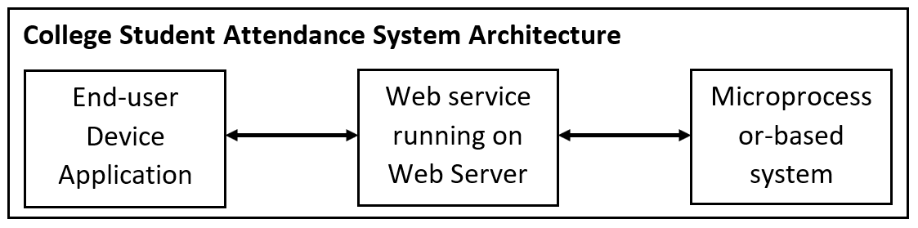

System Architecture

Slide 9
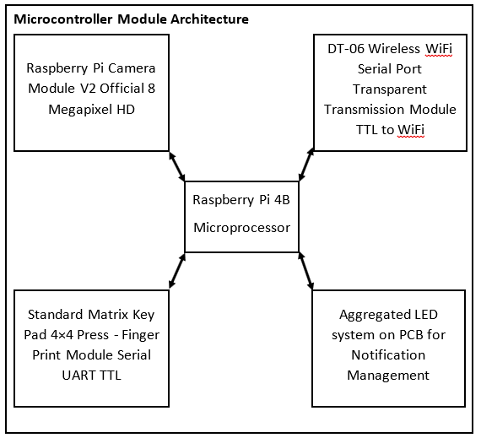

Slide 10
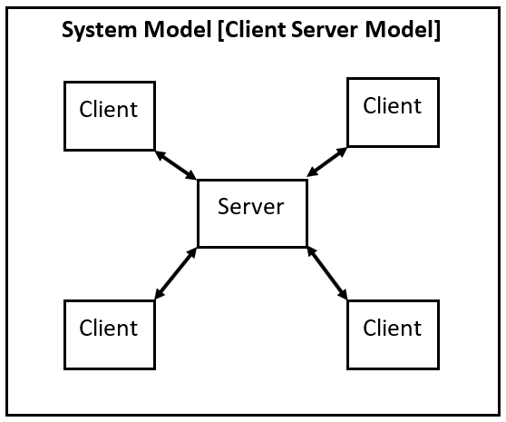

Slide 11
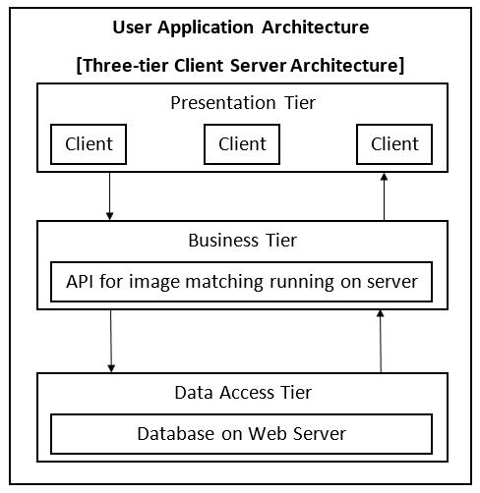

Slide 12
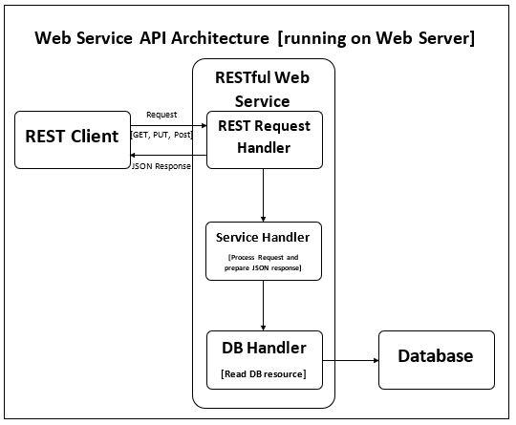

Slide 13
3.0 Design and Implementation

Slide 14
3.1 Web Service and API

Slide 15
2.4 Web Service and API
An API is an application programming interface. It is a set of rules that allow programs to talk to each other. The developer creates the API on the server and allows the client to talk to it.
REST determines how the API looks like. It stands for “Representational State Transfer”. It is a set of rules that developers follow when they create their API. One of these rules states that you should be able to get a piece of data (called a resource) when you link to a specific URL.
Each URL is called a request while the data sent back to you is called a response.

Slide 16
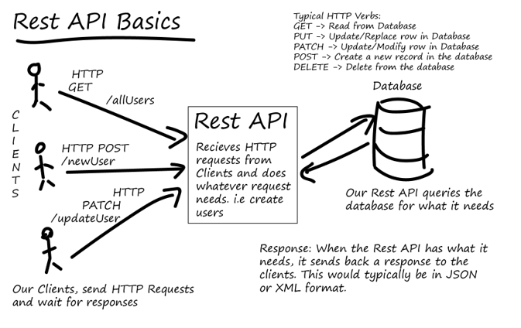
2.4 Web Service and API(Cont.)
Architecture:

Slide 17
2.4 Web Service and API
How we did it
We made two main services via our API; attendance resource and registration resource. The first handles both GET and POST requests for marking the attendance or getting the table of attendance back from the system. The second use the same two methods to register the student information into the database and sending back the registered students.
The web application then make use of this APIs and use them for the full functionality.

Slide 18
2.4 Web Service and API (Cont.)
Live Streaming
We used an open socket between the client and the server to receive the stream of frames from the camera and process them as they come.
In a traditional web app, the clients have no idea when the state of the server may have changed, so it either polls for changes every so often or just waits for the user to initiate the request.
Web-socket as possessed to http which is only one way communication that only happen when the users requests it. Web-socket allows for Contant communication between the server and the user and by extension all users on the app as long as the connection is opened.

Slide 19
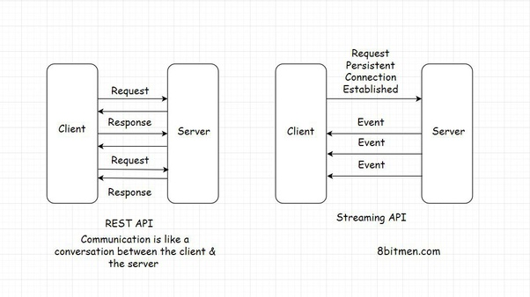
2.4 Web Service and API (Cont.)

Slide 20
3.2 Face Recognition and Image Processing

Slide 21
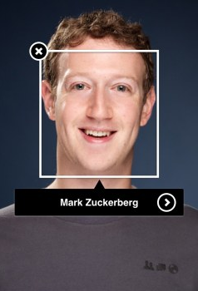
2.3 Face Recognition & Image Processing
Face Recognition Algorithm
First, look at a picture and find all the faces in it.
Second, focus on each face and be able to understand that even if a face is turned in a weird direction or in bad lighting, it is still the same person.
Third, be able to pick out unique features of the face that you can use to tell it apart from other people like how big the eyes are, how long the face is, etc.
Finally, compare the unique features of that face to all the people you already know to determine the person’s name.

Slide 22
2.3 Face Recognition & Image Processing (Cont.)
Face Recognition Python Package
It's the world’s simplest face recognition library which recognize and manipulate faces from Python or from the command line.
Built using dlib‘s state-of-the-art face recognition built with deep learning. The model has an accuracy of 99.38% on the Labeled Faces in the Wild benchmark.
This also provides a simple face_recognition command line tool that lets you do face recognition on a folder of images from the command line!

Slide 23
2.3 Face Recognition & Image Processing (Cont.)
Matching
After the user provide their information along with face picture and we store these information in the database, we start matching their new images (or in this case frames from the live feed of webcam). We process the image to find their faces using deep learning methodologies and then calculate the face encoding by its biometrics parameter (which is a list of 128 decimal numbers of the measurements of their face). After that, we compare these biometrics with the known encodings we hold in the database to see if any of them match and exceed the minimum limit.

Slide 24
2.3 Face Recognition & Image Processing (Cont.)
Efficiency and performance
To reduce the time complexity of the algorithm so that it performs faster and more smoothly, we resize the image (or in this case; the frame) through interpolation mechanisms to 25% of the original size so that we can still detect the face and at the same time maintaining rapid processing.
Also, to maximize the efficiency, we validate all the sent data before starting to work on the face recognition algorithms so that all the invalid requests are dropped.

Slide 25
3.3 Database

Slide 26
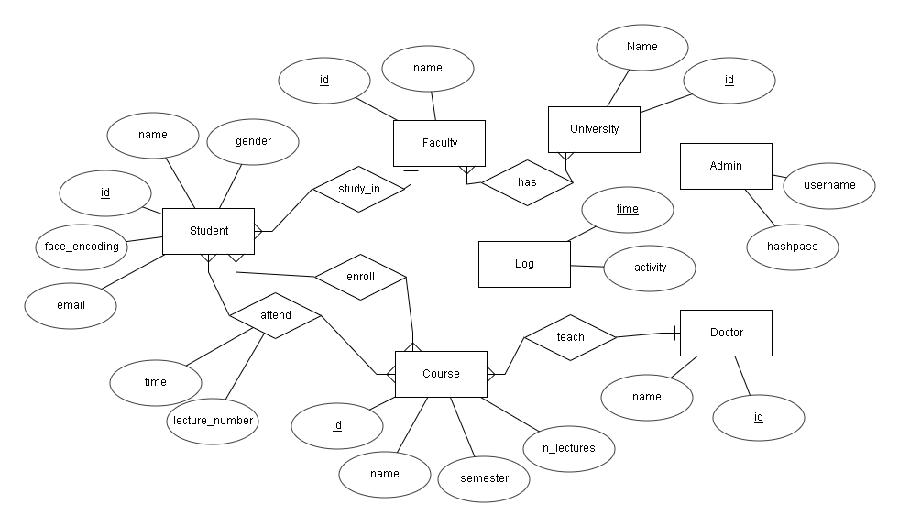
Entity Relational Diagram (ERD):

Slide 27
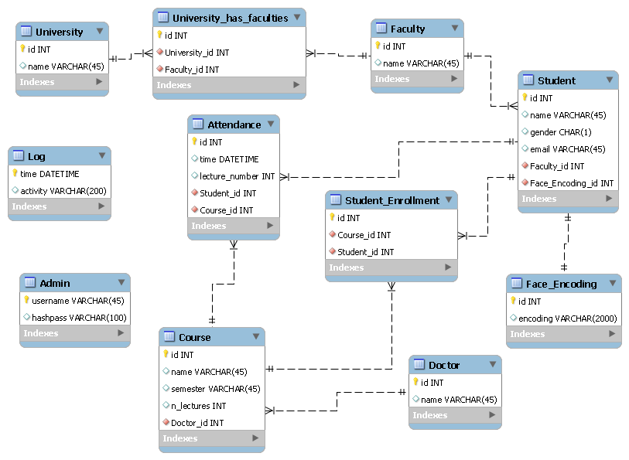
Relational Diagram (RD):

Slide 28
The Object Relational Mapper(ORM)
The ORM is constructed on top of the SQL Expression Language. It is a high level and abstracted pattern of usage.
the ORM may use the Expression Language directly where specific database interactions are required.

Slide 29
SQl Alchemy
The main objective of the Object Relational Mapper API of SQLAlchemy is to facilitate associating user-defined Python classes with database tables, and objects of those classes with rows in their corresponding tables.
SQLAlchemy enables expressing database queries in terms of user defined classes and their defined relationships.

Slide 30
Stages of using SQL Alchemy
Declaring Mapping
Base
Meta Data

Slide 31
3.4 Front End and UI

Slide 32
2.5 Front End and UI
The frontend of a software program or website is everything with which the user interacts.
Frontend is the bridge between a human and a system
From a user standpoint, the frontend is synonymous with the user interface.
From a developer standpoint, it is the interface design and the programming that makes the interface function.
Conversely, the backend includes functions and data processing that takes place behind the scenes.

Slide 33
2.5 Front End and UI (cont.)
Process:
The web design process starts with a visual concept, which you could sketch by hand or with software like Photoshop.
Then, you use HTML and CSS to build the website.
HTML handles the basic structure and bones of your page, while CSS handles the style and appearance.

Slide 34
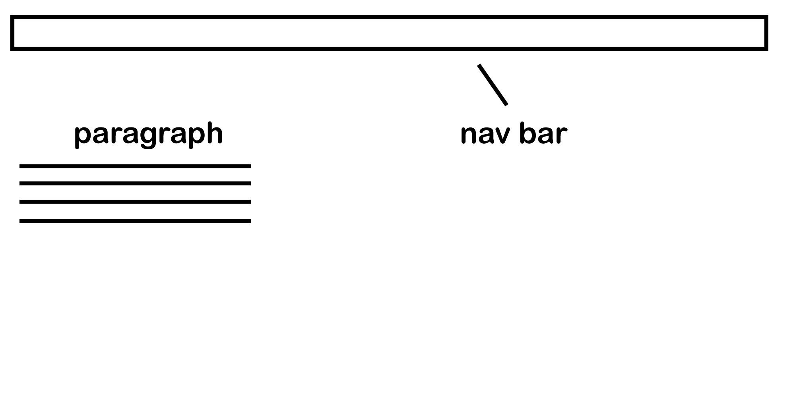
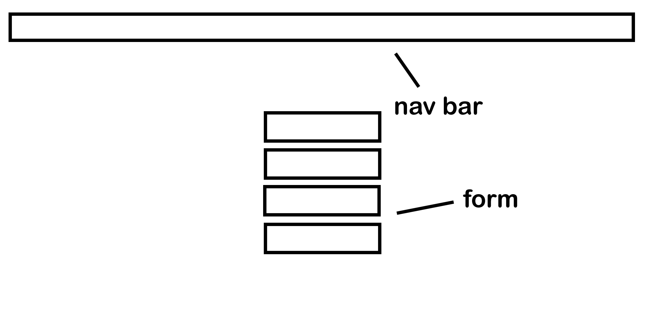
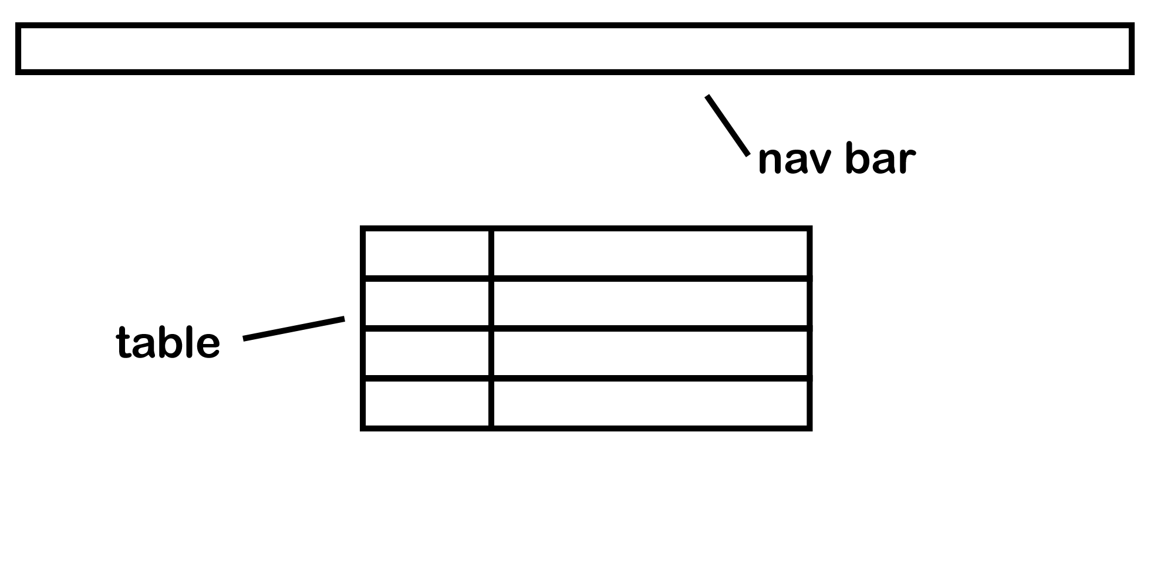
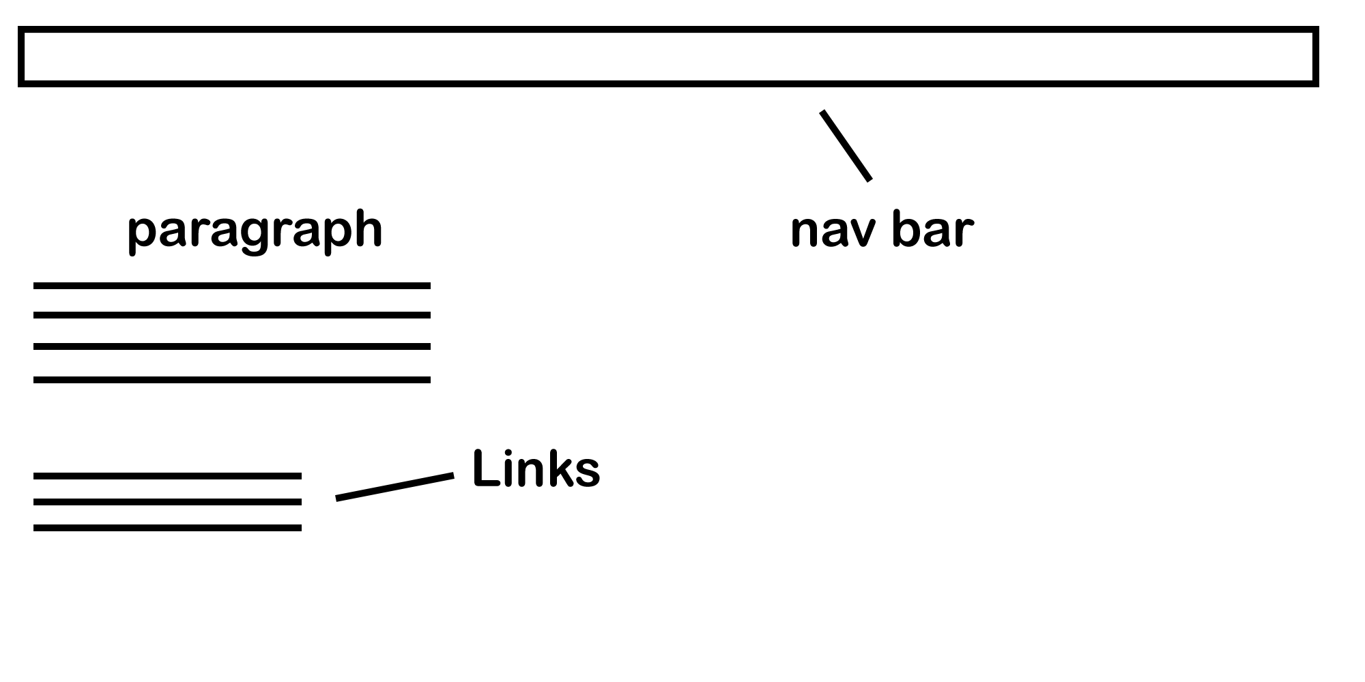
2.5 Front End and UI (cont.)
Sketch:

Slide 35
2.5 Front End and UI (cont.)
User Experience
What the person feels as he experiences a product or service .
Important role in all kinds of marketing .
Bridge between system and it's targeted audience .

Slide 36
2.5 Front End and UI (cont.)
UX's Role
Is to algin and ensure we get there , balancing the needs of the business & technology with needs of people .
The benefit of UX
Faster way to better solution
More successful and effective work
Greater productivity and way to push Innovation

Slide 37
2.5 Front End and UI (cont.)
UX is user-centered
As a UX designer, you should consider the Why, What and How of product use.
The Why involves the users’ motivations for adopting a product, whether they relate to a task they wish to perform with it or to values and views which users associate with the ownership and use of the product.
The What addresses the things people can do with a product—its functionality.
Finally, the How relates to the design of functionality in an accessible and aesthetically pleasant way.
UX designers start with the Why before determining the What and then, finally, the How in order to create products that users can form meaningful experiences with.

Slide 38
2.5 Front End and UI (Languages and frameworks)
HTML
makes up the layout and structure for your website.
CSS:
is used hand with HTML to add colors backgrounds, layouts, font sizes and more.
JavaScript:
Web developers use this language to add interactive elements to their websites.
Bootstrap:
is a free, open-source HTML, CSS, and JS framework containing templates for text, forms, buttons, navigation, and other relevant interface components.

Slide 39
4.0 Testing

Slide 40

Selenium
It is an open-source browser based test automation software mainly used for functional testing.

Slide 41
Page Objects Design Pattern
A page object represents an area in the web application user interface that your test is interacting.
Benefits of using page object pattern:
Creating reusable code that can be shared across multiple test cases
Reducing the amount of duplicated code
If the user interface changes, the fix needs changes in only one place

Slide 42
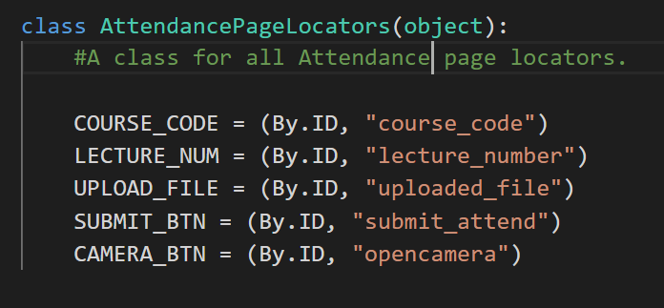
Locators
locators of the same page belong to same class.
Elements can be located by: ID, class, name, or XPath

Slide 43
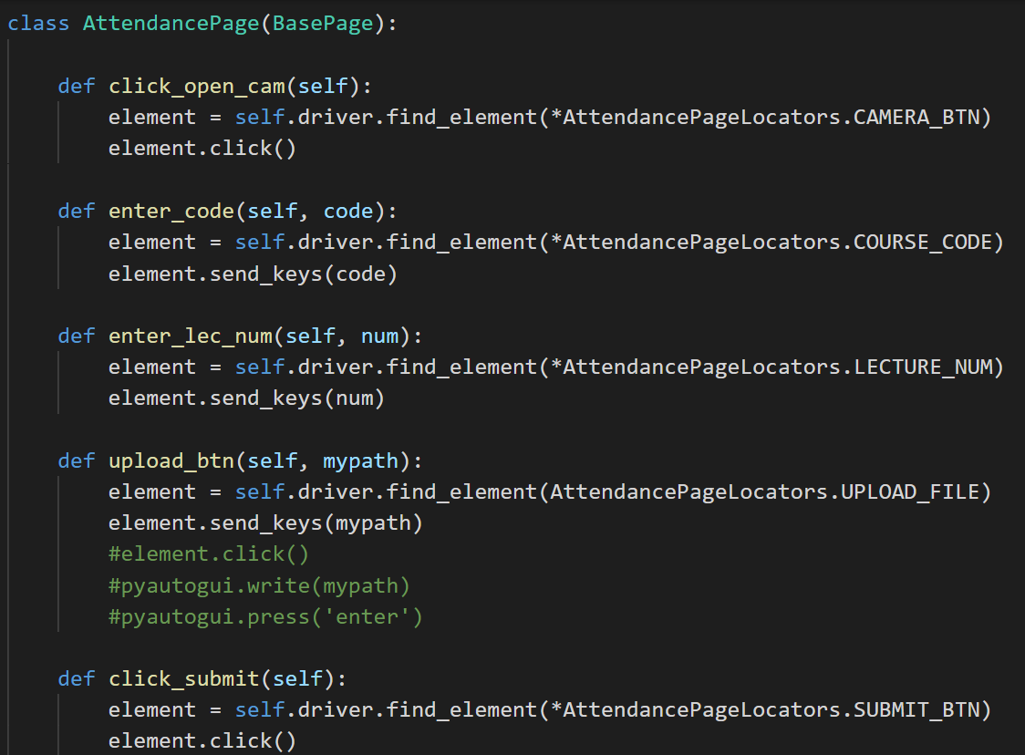
Page object classes
The page object pattern intends creating an object for each web page.

Slide 44
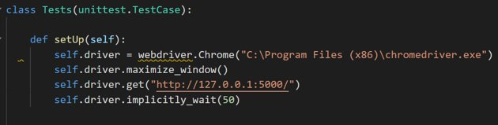
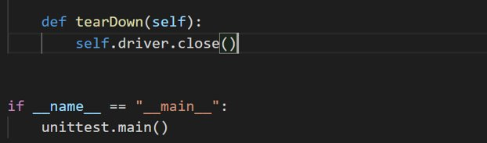
Test Cases
The actual test cases are written in the main.py file
It must have two main functions:
setup()
teardown()

Slide 45
3.0 Security

Slide 46


Security
Tested Vulnerability (Injection)
- such as SQL, NoSQL, OS, and LDAP injection, occur when untrusted data is sent to an interpreter as part of a command or query. The attacker’s hostile data can trick the interpreter into executing unintended commands or accessing data without proper authorization.
- If you have any "special" characters (such as semicolons or apostrophes) in your data, they will be automatically quoted for you by the SQLEngine object, so you don't have to worry about quoting. This also means that unless you deliberately bypass SQLAlchemy's quoting mechanisms, SQL-injection attacks are basically impossible.

Slide 47
Security (Cont.)
2. Cross-Site Scripting (XSS).
XSS flaws occur whenever an application includes untrusted data in a new web page without proper validation or escaping or updates an existing web page with user-supplied data using a browser API that can create HTML or JavaScript. XSS allows attackers to execute scripts in the victim’s browser which can hijack user sessions, deface web sites, or redirect the user to malicious sites.
by default, everything flask outputs via jinja2 is HTML escaped so that even if you display a user generated string it is guaranteed not to contain any malicious javascript/html codes.

Slide 48
Security (Cont.)
3. Directory traversal
also known as file path traversal is a web security vulnerability that allows an attacker to read arbitrary files on the server that is running an application. This might include application code and data, credentials for back-end systems, and sensitive operating system files. In some cases, an attacker might be able to write to arbitrary files on the server, allowing them to modify application data or behavior, and ultimately take full control of the server.

Slide 49
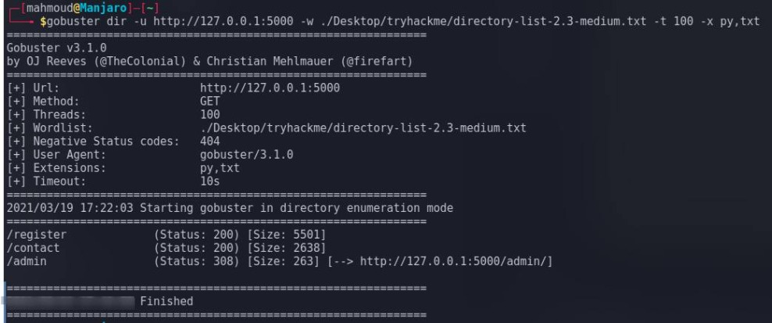
Security (Cont.)
Directory traversal

Slide 50
Security (Cont.)
4. A cross site request forgery (CSRF) token
It is a unique, secret, unpredictable value that is generated by the server-side application and transmitted to the client in such a way that it is included in a subsequent HTTP request made by the client. When the later request is made, the server-side application validates that the request includes the expected token and rejects the request if the token is missing or invalid.
Any view using FlaskForm to process the request is already getting CSRF protection.

Slide 51
Security (Cont.)
5. Password Hashing
A strong password storage strategy is critical to mitigating data breaches that put the reputation of any organization in danger. Hashing is the foundation of secure password storage.
In cryptography, a hash function is a mathematical algorithm that maps data of any size to a bit string of a fixed size. We can refer to the function input as message or simply as input. The fixed-size string function output is known as the hash or the message digest. As stated by OWASP.

Slide 52
Security (Cont.)
Using Components with Known Vulnerabilities. Components, such as libraries, frameworks, and other software modules, run with the same privileges as the application. If a vulnerable component is exploited, such an attack can facilitate serious data loss or server takeover.
Applications and APIs using components with known vulnerabilities may undermine application defenses and enable various attacks.
Insufficient Logging & Monitoring. Insufficient logging and monitoring, coupled with missing or ineffective integration with incident response, allows attackers to further attack systems, maintain persistence, pivot to more systems, and tamper, extract, or destroy data

Slide 53
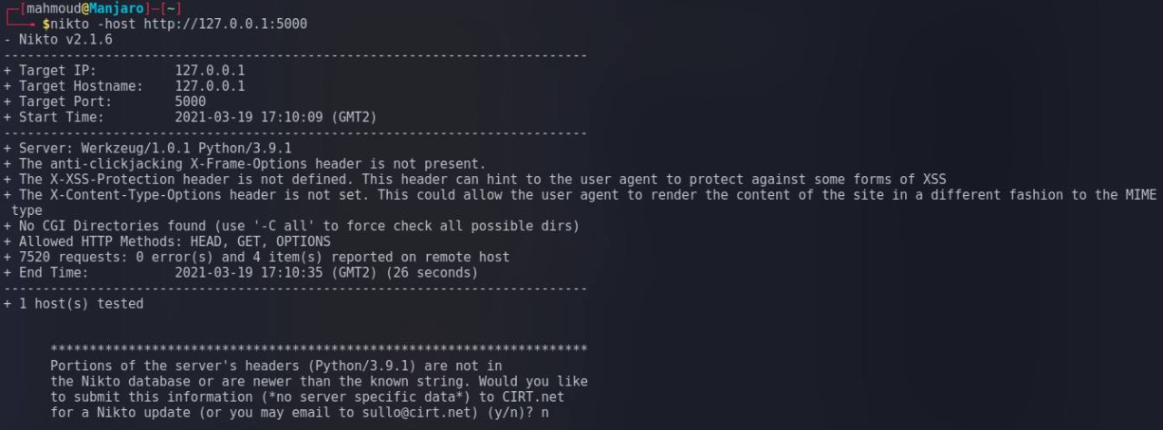
Security (Cont.)

Slide 54
5.0 System Hardware Components Configuration and Specification

Slide 55

What is the Raspberry Pi?
Single-Board Computers [SBC]
Has Broadcom System on a Chip(SoC) with and integrated ARM CPU and on-chip graphics processing unit (GPU)

Slide 56
Raspberry Pi Generations
Raspberry Pi Model B
Raspberry Pi Model A
Raspberry Pi Model B+
Raspberry Pi 2
Raspberry Pi Zero
Raspberry Pi Zero W
Raspberry Pi Zero WH
Raspberry Pi 3 Model B
Raspberry Pi 3 Model B+
Raspberry Pi 4 Model B
Raspberry Pi 400
Raspberry Pi Pico

Slide 57
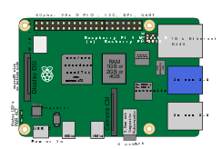
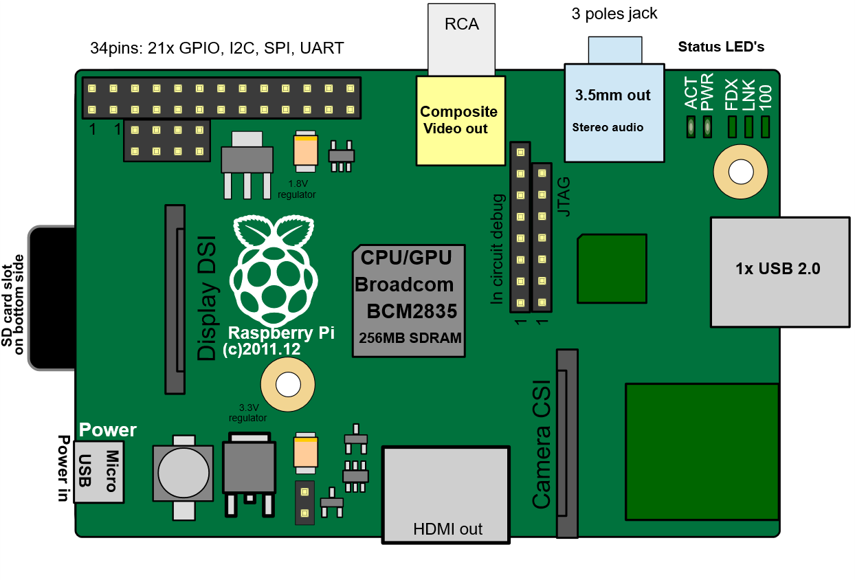
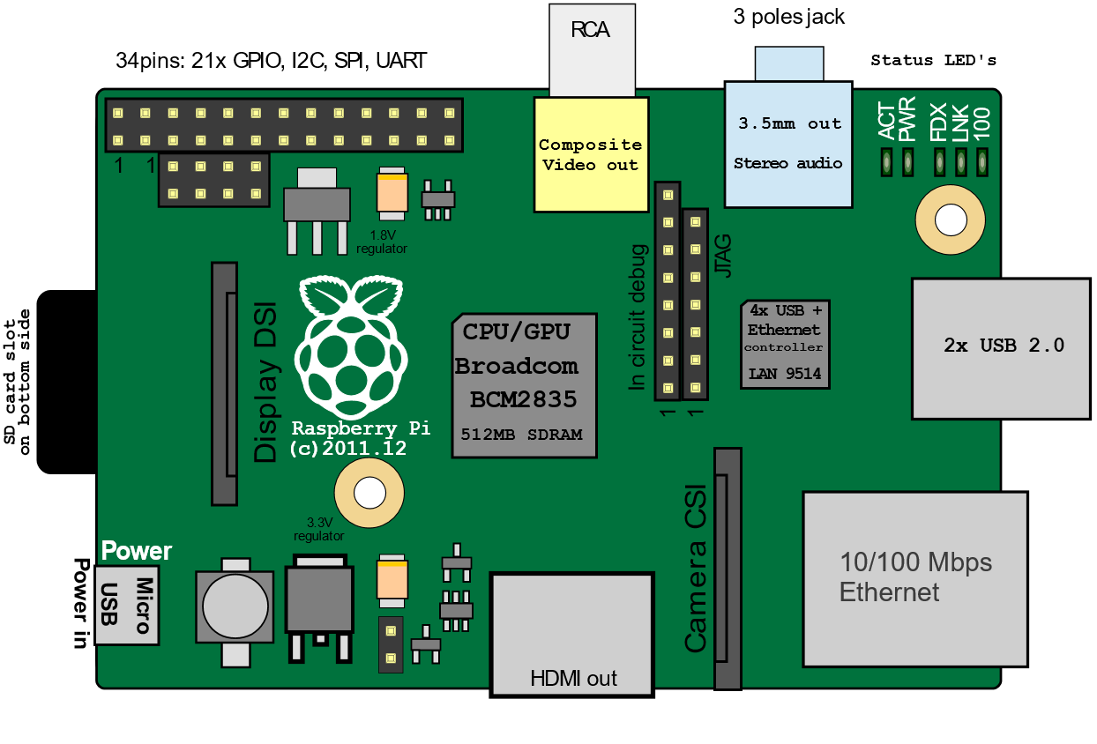
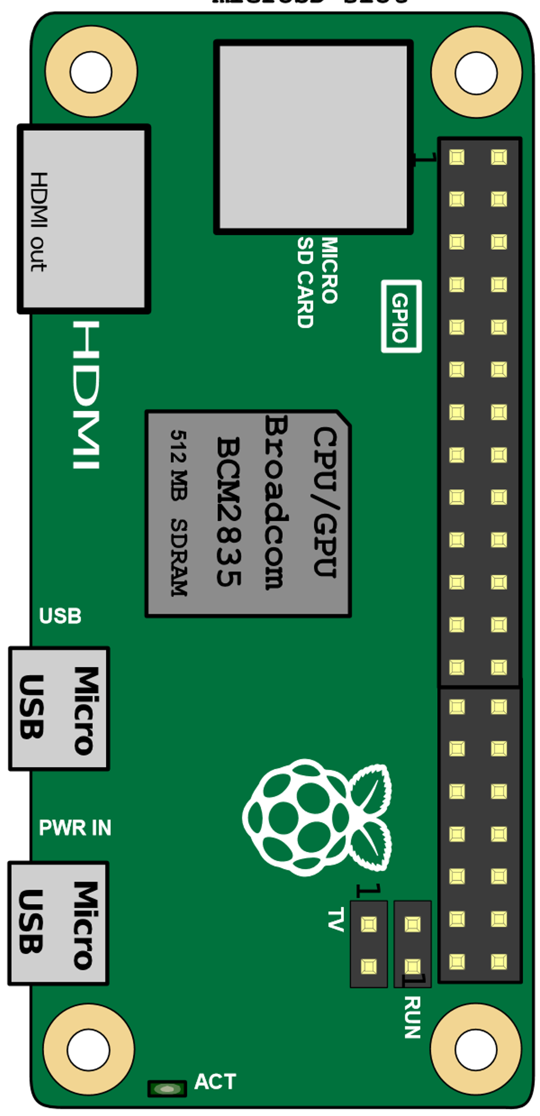
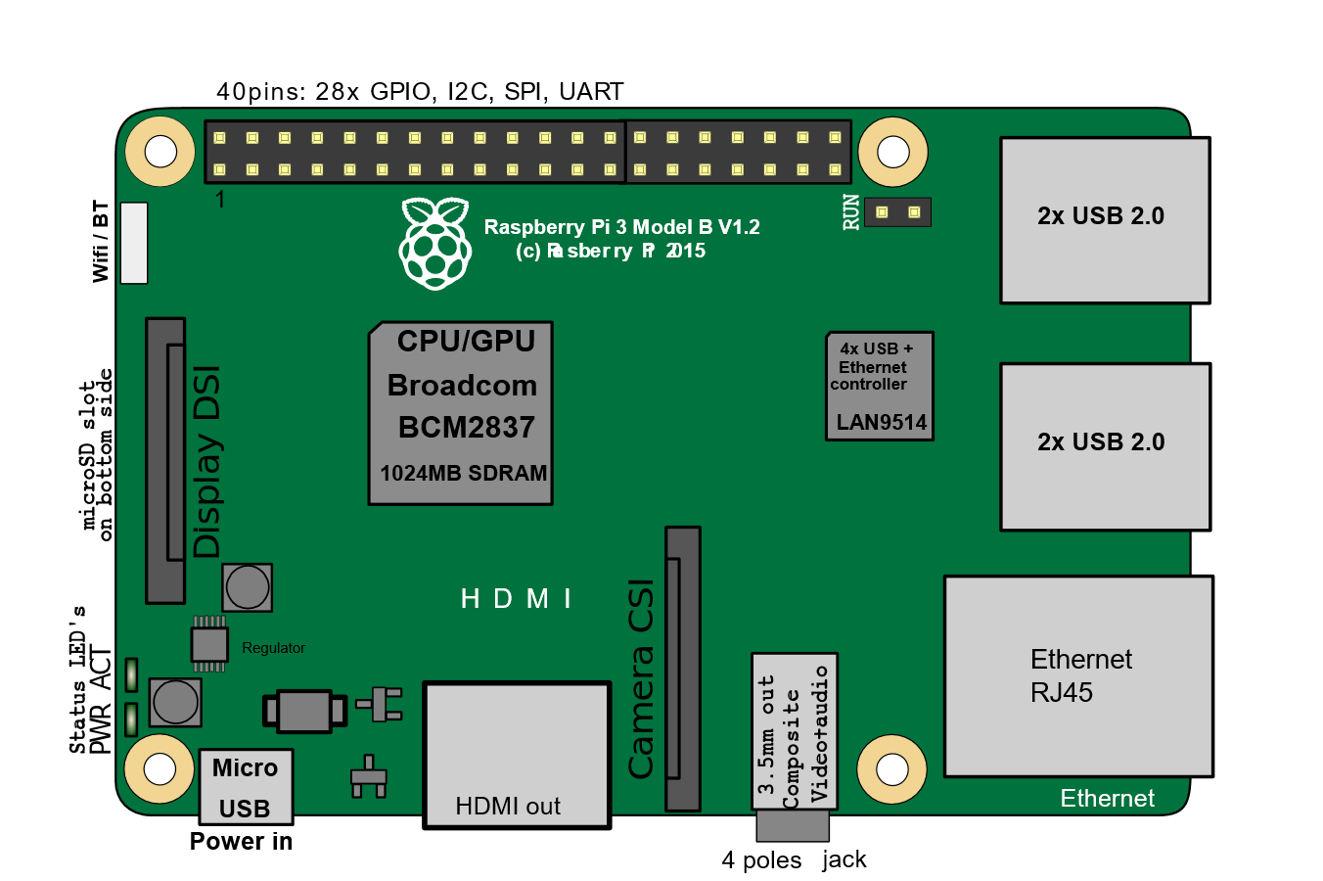
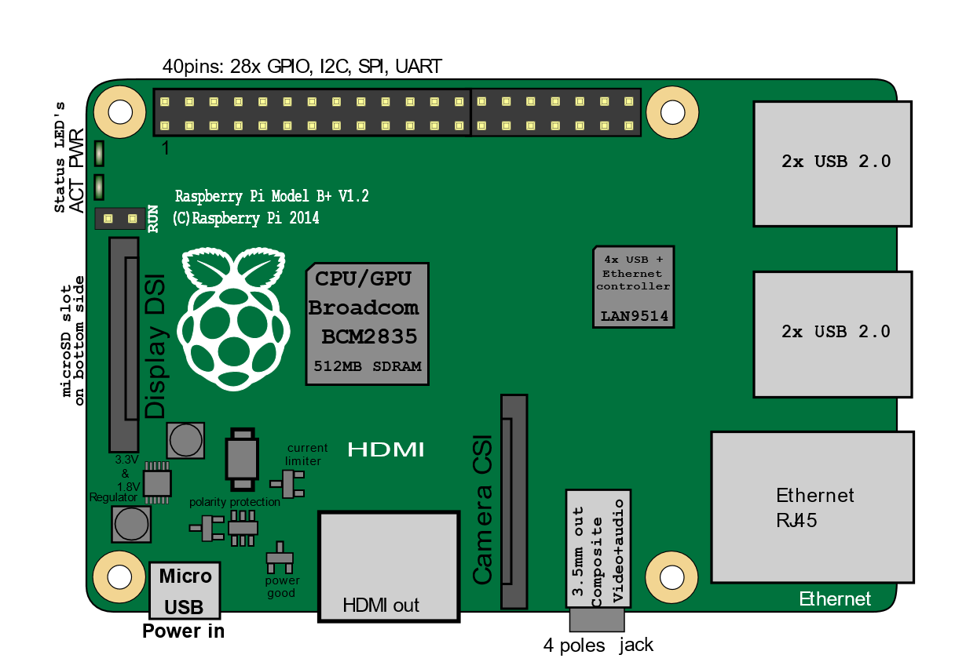
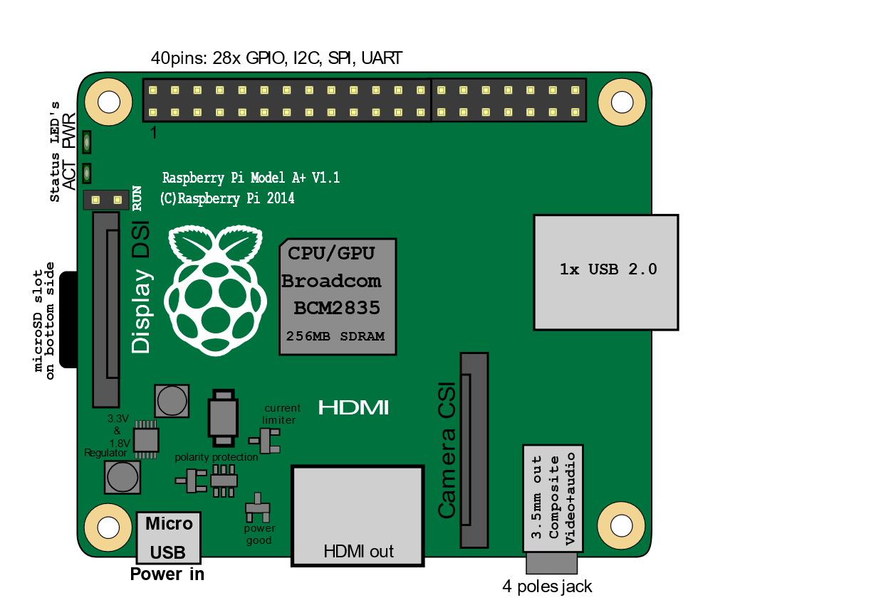

Slide 58
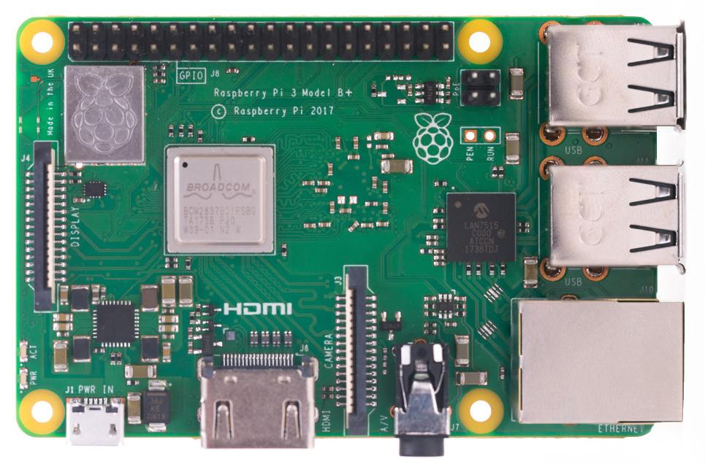
Processing Platform: Raspberry Pi 3 Model B+

Slide 59
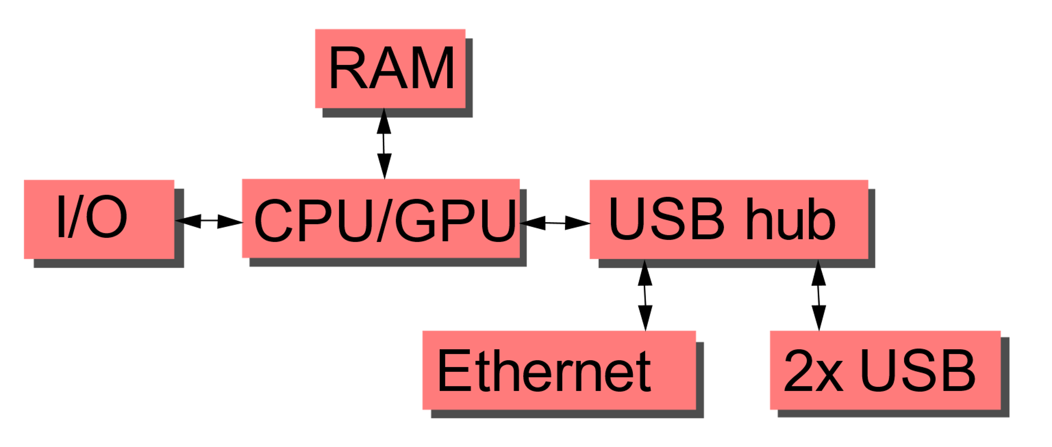
Raspberry Pi 3 Model B+ Block Function

Slide 60
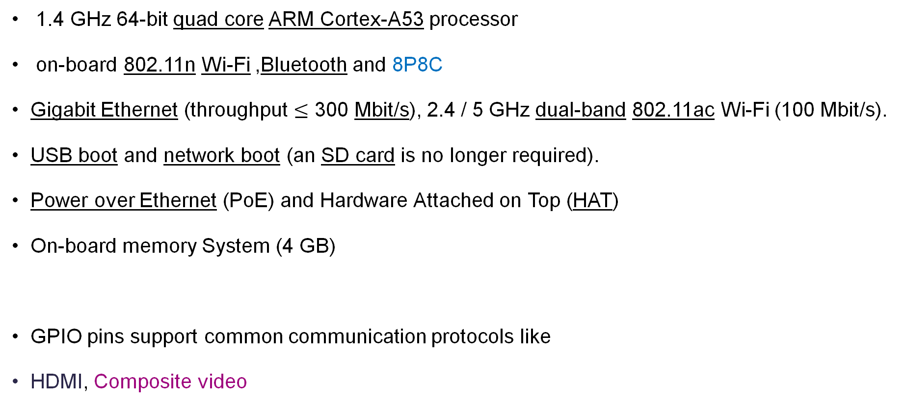

Raspberry Pi 3 Model B+
1.4 GHz 64-bit quad core ARM Cortex-A53 processor
on-board 802.11n Wi-Fi ,Bluetooth and 8P8C
Gigabit Ethernet (throughput $≤$ 300 Mbit/s), 2.4 / 5 GHz dual-band 802.11ac Wi-Fi (100 Mbit/s).
USB boot and network boot (an SD card is no longer required).
Power over Ethernet (PoE) and Hardware Attached on Top (HAT)
On-board memory System (4 GB)
GPIO pins support common communication protocols like
HDMI, Composite video
8 position 8 contact (8P8C)
HAT board carries a small EEPROM containing the relevant details of the board, so that the Raspberry Pi's OS is informed of the HAT, and the technical details of it, relevant to the OS using the HAT.
is a synchronous, multi-master, multi-slave, packet switched, single-ended, serial communication bus
$$I^{2}C$$
audio/video interface for transmitting uncompressed
video data and compressed or uncompressed digital audio data from an HDMI-compliant source device.
an analog video signal format that carries standard-definition video (typically at 480i or 576i resolution) as a single channel.

Slide 61
Processor ARM Cortex-A53
Microarchitectures implementing the ARMv8-A 64-bit instruction set
2-wide decode superscalar processor, capable of dual-issuing some instructions.
8-stage pipelined processor with 2-way superscalar, in-order execution pipeline
DSP and NEON SIMD extensions are mandatory per core
VFPv4 Floating Point Unit onboard (per core)
Hardware virtualization support
TrustZone security extensions
64-byte cache lines
10-entry L1 TLB, and 512-entry L2 TLB
4 KiB conditional branch predictor, 256-entry indirect branch predictor

Slide 62
Processor ARM Cortex-A53 Performance
Ten times the performance of a Raspberry Pi 1.
Benchmarks showed the Raspberry Pi 3 to be approximately 80% faster than the Raspberry Pi 2 in parallelized tasks.

Slide 63
OverClocking
Most Raspberry Pi systems-on-chip could be overclocked
In the Raspbian Linux distro the overclocking options on boot can be done by a software command running "sudo raspi-config“
In those cases the Pi automatically shuts the overclocking down if the chip temperature reaches 85 °C (185 °F)
An appropriately sized heat sink is needed to protect the chip from serious overheating.
Firmware contain the option to choose between five overclock ("turbo") presets that, when used, attempt to maximize the performance of the SoC without impairing the lifetime of the board.
This is done by monitoring the core temperature of the chip and the CPU load, and dynamically adjusting clock speeds and the core voltage.
Pi 3; 1100 MHz ARM, 550 MHz core, 500 MHz SDRAM, 6 overvolting. In system information the CPU speed appears as 1200 MHz. When idling, speed lowers to 600 MHz.

Slide 64
Random Access Memory (RAM)
256 MiB, 384 MiB, and 496 MiB CPU RAM
256 MiB, 128 MiB, and 16 MiB video RAM
The foundation released a new version of start.elf that could read a new entry in config.txt (gpu_mem=xx) and could dynamically assign an amount of RAM (from 16 to 256 MiB in 8 MiB steps) to the GPU, obsoleting the older method of splitting memory, and a single start.elf worked the same for 256 MiB and 512 MiB Raspberry Pi.
The Raspberry Pi 3 has 1 GiB of RAM in the B and B+ models.

Slide 65
Video Controller
Raspberry Pi 3 does not have H.265 decoding hardware, the CPU is more powerful than its predecessors, potentially fast enough to allow the decoding of H.265-encoded videos in software.
The GPU in the Raspberry Pi 3 runs at higher clock frequencies of 300 MHz or 400 MHz, compared to previous versions which ran at 250 MHz.
High Efficiency Video Coding (HEVC), also known as H.265 and MPEG-H Part 2, is a video compression standard
It supports resolutions up to 8192×4320
the second most widely used video coding format
work by comparing different parts of a frame of video to find areas that are redundant, both within a single frame and between consecutive frames. These redundant areas are then replaced with a short description instead of the original pixels.

Slide 66
Real-time clock
When booting, the time defaults to being set over the network using the Network Time Protocol (NTP).
The source of time information can be another computer on the local network that does have a real-time clock, or to a NTP server on the internet which in turn gets time information from an atomic clock at the National Institute of Standards and Technology (NIST).
If no network connection is available, the time may be set manually or configured to assume that no time passed during the shutdown.
NTP is intended to synchronize all participating computers to within a few milliseconds of Coordinated Universal Time (UTC).

Slide 67
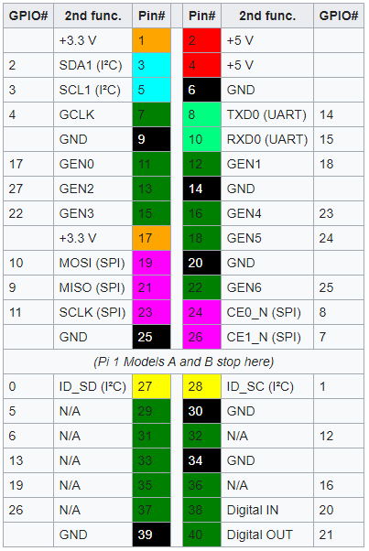
General purpose input-output (GPIO) connector
Pi 3 Model B+ have a 40-pin pinout.
Illustrated in the following table

Slide 68
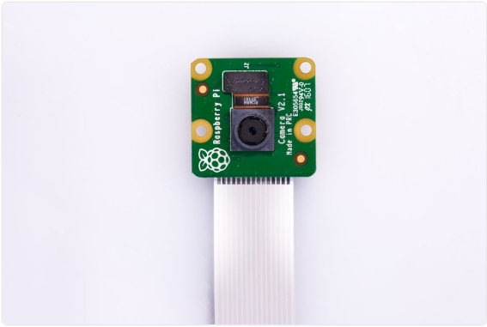
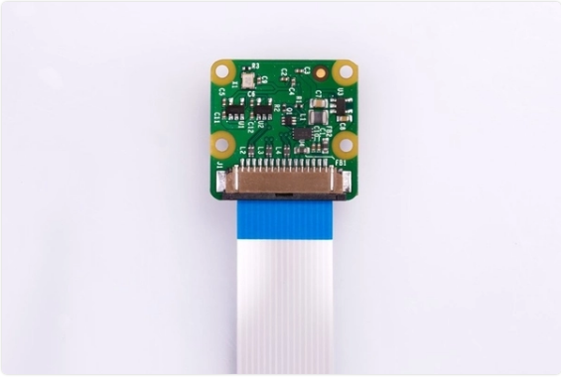
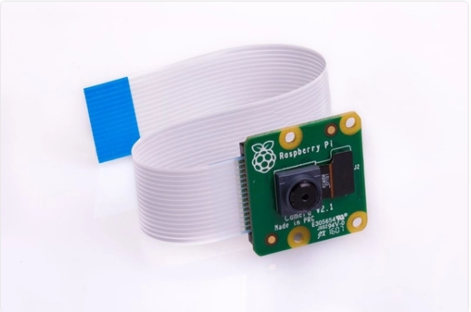
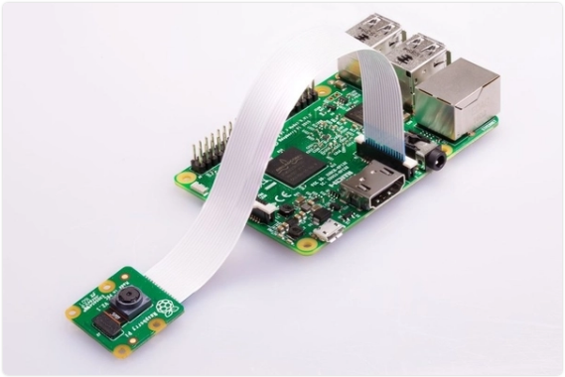
Camera Module

Slide 69
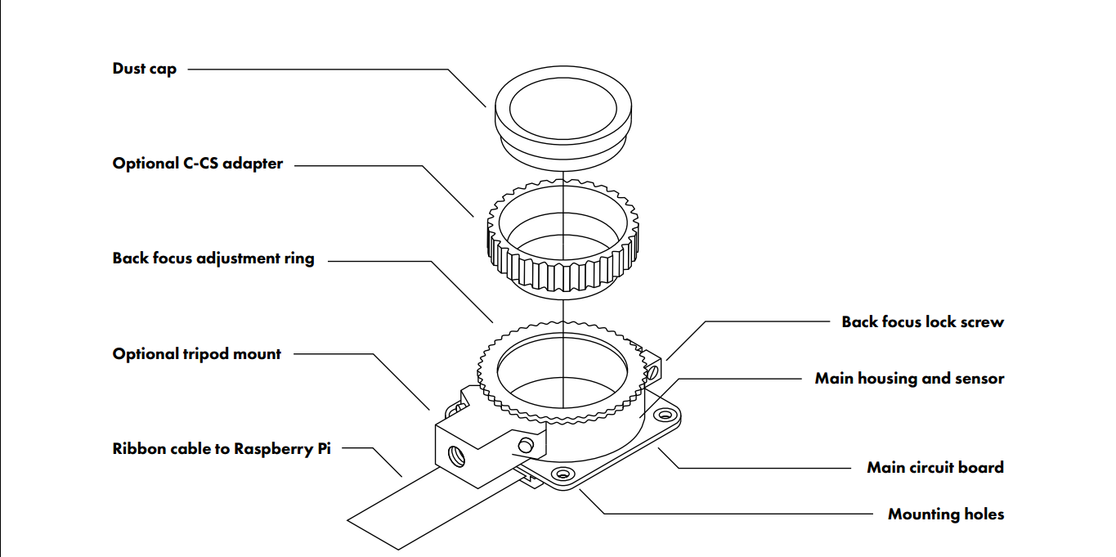
Camera Module Mechanical Assembly

Slide 70
Camera Module Specification
The V4L2 Linux kernel framework allows to control both an external camera sensor and the camera interface in order to capture raw frames in various formats.
Sony IMX219 8-megapixel sensor
Can be used to take high-definition video
Resolution: 8 Megapixels
Linux Integration: V4L2 driver available
Can be used to take high-definition video
Supports 1080p30, 720p60 and VGA90 video modes
It attaches via a 15cm ribbon cable to the CSI port on the Raspberry Pi.
Supports 1080p30, 720p60 and VGA90 video modes
C programming API: OpenMAX IL and others available
The Camera Serial Interface (CSI) is a specification of the Mobile Industry Processor Interface (MIPI) Alliance. It defines an interface between a camera and a host processor.
OpenMAX IL defines a low-level interface for audio, video, and imaging codecs used in embedded and/or mobile devices, freeing the developer from having to use proprietary or closed interfaces. It allows applications and media frameworks to interface with multimedia codecs and supporting components in a unified manner.

Slide 71
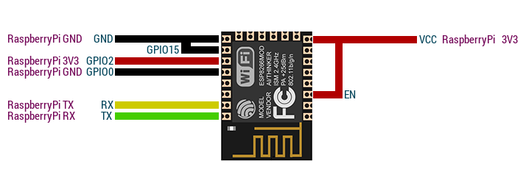
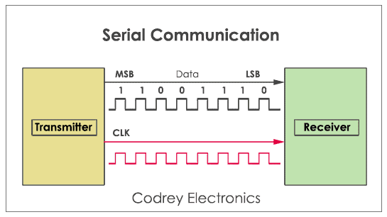
Wi-Fi Serial TTL Module "ESP8266-12E"
TTL stands for Transistor-Transistor Logic, a serial communication commonly found in UART (universally asynchronous receiver/transmitter) transmission method, a method seen in most microcontrollers.
Advantages:
Low cost
High availability
High compatibility with microcontroller
Ease of usage
A universal asynchronous receiver-transmitter (UART) is a computer hardware device for asynchronous serial communication in which the data format and transmission speeds are configurable.

Slide 72
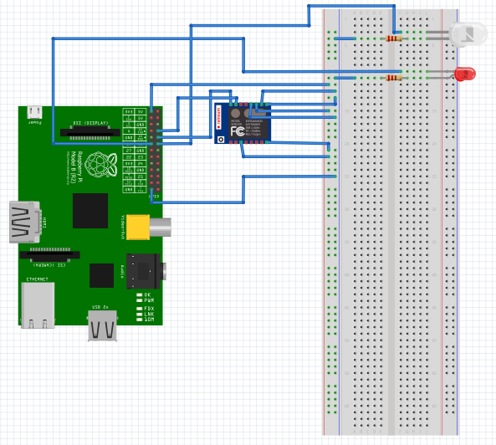

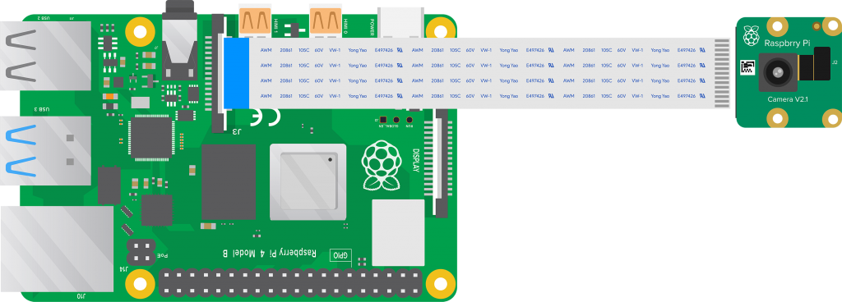
System Physical Configuration

Slide 73
Components List
Name | Price
Raspberry Pi Camera Module V2 | EGP 850.00
Heat Sink for Raspberry Pi Board 3 | EGP 20.00
Adapter Fixed Micro USB Output 5Vdc | EGP 75.00
Raspberry Pi 3 – Model B – V1.2 element14 | EGP 1350.00
Bread Board 1560 | EGP 125.00
Male to Male 40 Jumper Set *2 | EGP 44.00
Wi-Fi Serial TTL Module | EGP 85.00
Total | EGP 2549.00

Slide 74
7.0 System Requirements Specification (SRS)

Slide 75
7.1 Introduction
Requirement Engineering :
The process of establishing the services that the customer requires from a system and the constrains under which it operates and is developed .
The requirements themselves are the descriptions of the system services and constrains that are generated during the requirements engineering process .

Slide 76
7.1 Introduction
User Requirements :
Statements in natural language plus diagrams of the services the system provides and its operational constrains written for customers .
System Requirements :
A structured document setting out detailed descriptions of the system functions , services and operational constrains .

Slide 77
7.2 Requirements specification
The process of writing the user and system requirements in a requirements document .
User requirements have to be understandable by end-users and customers who do not have a technical background .
System requirements are more detailed requirements and may include more technical information .
In principle , requirements should state what the system should do and the design should describe how it does this .

Slide 78
7.3 System Requirements Specification
The system should be running and continuously taking pictures via a qualified camera during the lecture time and keep adding the attendance of the people it identifies until the end of the lecture . This gathered information is then stored and structured in a database . Student's data will be added to the attendance table with the time of attending and the lecture number .
A database must be made to hold all the important information about and required by the system . This database should be a relational database that holds tables about different entities of the system with all the attributes or fields necessary about that specific entity . One of these entities is the student ; the system should have the full name , student id , email , university , faculty , and the different courses that the student is registered in . Also , the face encodings of that specific student so that the system knows his face .

Slide 79
7.4 System Requirements Specification
The database should follow the ACID (atomicity , consistency , isolation , durability) properties which is a set of properties of database transactions intended to guarantee data validity despite errors , power failures , and other mishaps . the database must have a backup and replications in case of any data-loss . The Quality of the database is maintained in such a way so that it can be very user friendly to all the users of the database .
Different universities can be added to the system and work as a distributed system with maintaining the integrity and security of each one of them . The admins or university staff at each university can only work with the data for this specific university and not be able to comprise or manipulate any other data . The university staff must provide the necessary information about the different faculties , doctors and courses for the university before the system production .

Slide 80
7.4 System Requirements Specification
The student must register on the system to be able to identify him before he can take attendance and that happens via a web form the student must fill and provide his picture to upload it on the server . Each student will be able to choose his faculty while registering . After student registration , the system should analyze the picture he provided and detect his face and reject the picture if the picture turns out to have multiple faces or if doesn’t contain a face at all . And if the picture passes these conditions , the system should get the encodings of that face and store them in the database .
Any passwords or sensitive information cannot be stored in plain text but rather must be hashed to secure it . Using any hash generator algorithm to generate a hash of each password in the database to protect the user’s password in case of a data leak . the hash value will be unique for each password . Each Doctor can add his courses to the database . Each course has a unique code and table of students . Students will be able to register for these courses and then attend it .

Slide 81
7.4 System Requirements Specification
Instructors will send warnings to students if they are near to the allowed limit of absence in any course . It will make it easier for doctors to communicate with students and easier for students to keep track of their absence . The allowed limit of absence will be set by the faculty staff . Also , the doctor will receive remainders or warnings if there is a deadline or some of the students are about to violate one of the university attendances rules (e.g. , absence more than three lectures in a row) . Therefore , the students should be informed and send the reasons for their absence .

Slide 82
11.0 References
https://flask.palletsprojects.com/en/1.1.x/
https://docs.sqlalchemy.org/en/14/
https://pypi.org/project/face-recognition/
https://getbootstrap.com/docs/4.1/getting-started/introduction/
https://flask-restful.readthedocs.io/en/latest/
https://wtforms.readthedocs.io/en/2.3.x/
https://docs.python.org/
https://www.npmjs.com/package/bcrypt
https://flask-admin.readthedocs.io/en/latest/
https://jinja.palletsprojects.com/
https://www.raspberrypi.org/documentation/linux/software/libcamera/README.md

Slide 83
11.0 Refernces (Cont.)
https://docs.opencv.org/
https://selenium-python.readthedocs.io/installation.html#introduction
https://docs.python.org/3/library/unittest.html#test-cases
https://portswigger.net/web-security
https://owasp.org/www-project-top-ten/
https://www.raspberrypi.org/documentation/hardware/raspberrypi/bcm2837/README.md
https://www.raspberrypi.org/documentation/hardware/raspberrypi/bcm2836/QA7_rev3.4.pdf
https://www.raspberrypi.org/documentation/linux/software/libcamera/csi-2-usage.md
https://www.raspberrypi.org/documentation/hardware/raspberrypi/frequency-management.md
https://www.raspberrypi.org/documentation/raspbian/applications/camera.md
https://www.raspberrypi.org/documentation/configuration/wireless/README.md
https://www.raspberrypi.org/documentation/linux/usage/scripting.md

